Slide 1
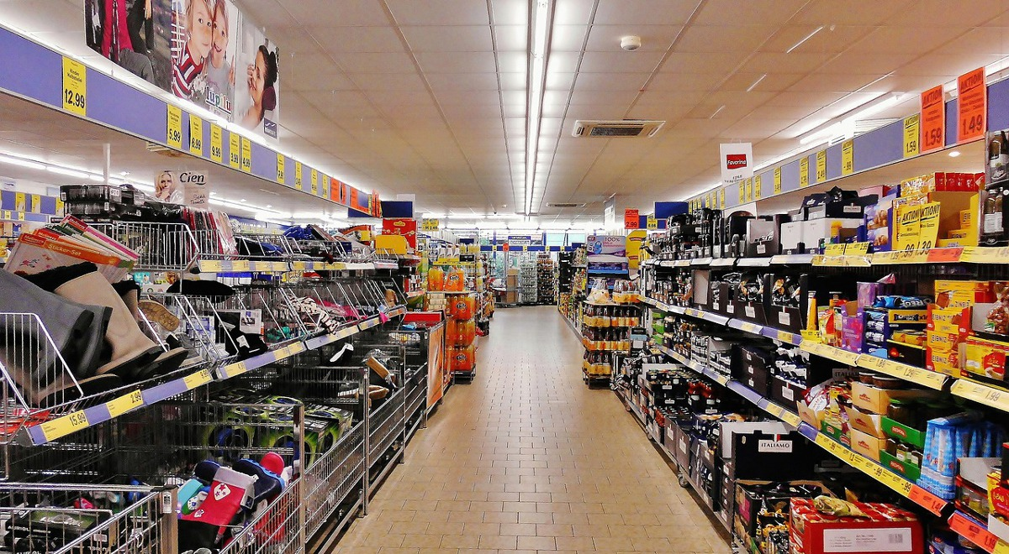
Asking for help in the shop

Slide 2
You are in a shop and you can’t find the biscuits…

Slide 3
The oranges have no price label…

Slide 4
Someone pushes in front of you…

Slide 5
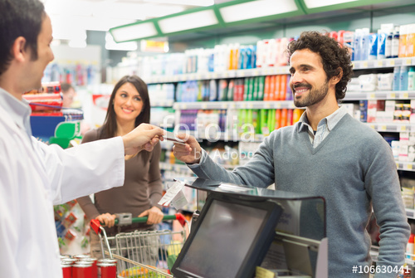
The assistant give you the wrong change.

Slide 6
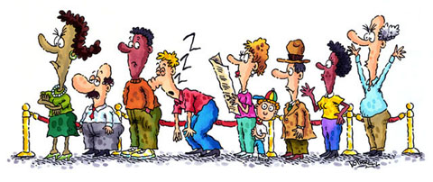
Someone behind you in the queue feels ill.

Slide 7
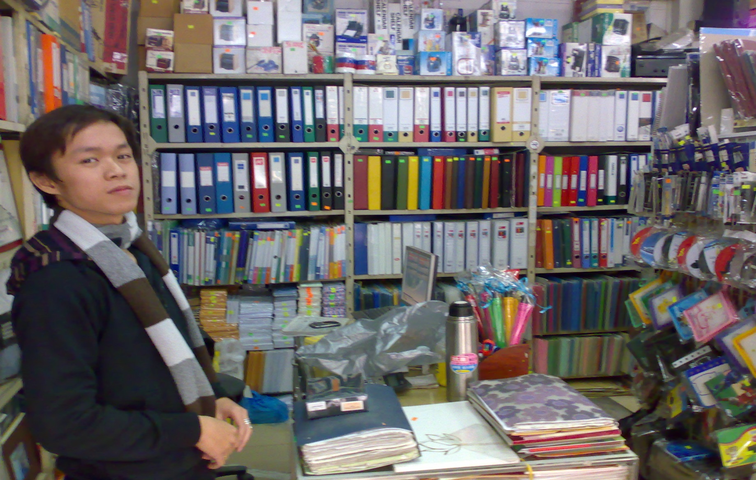
You are buying equipment for school but you can’t find the pens…

Slide 8
You are shopping when you suddenly need the toilet…

